Slide 1
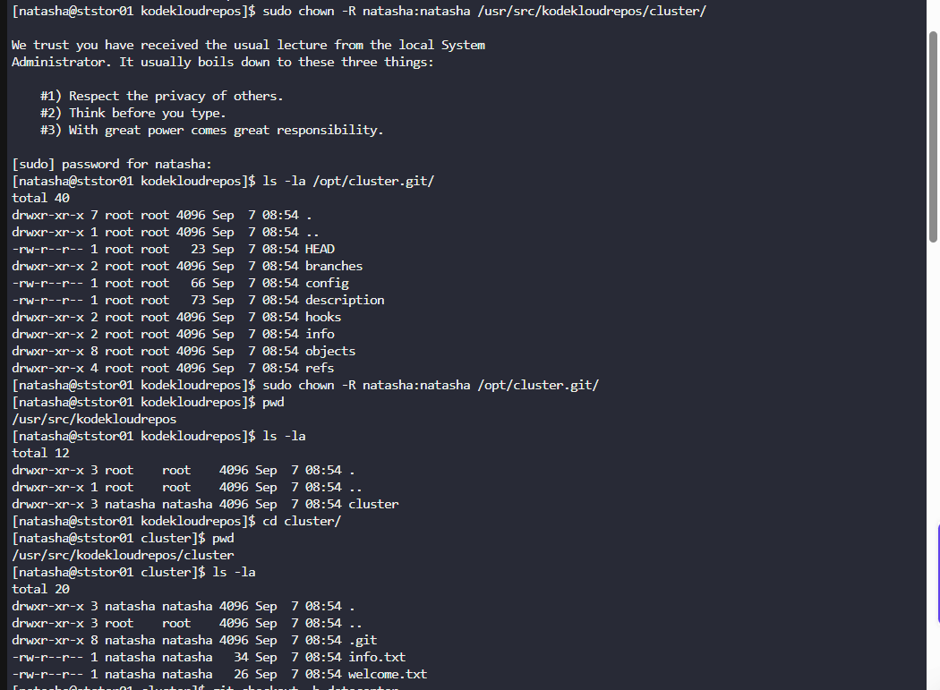
1.Create a new branch datacenter in /usr/src/kodekloudrepos/cluster repo from master and copy the /tmp/index.html file (present on storage server itself) into the repo. 2. Further, add/commit this file in the new branch and merge back that branch into master branch. 3. Finally, push the changes to the origin for both of the branches.

Slide 2
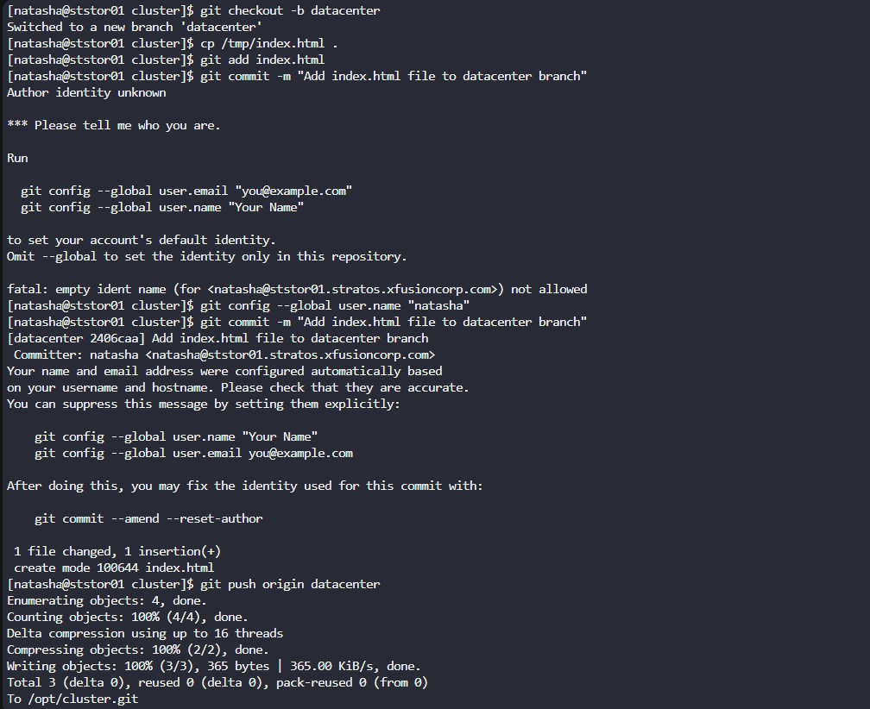

Slide 3
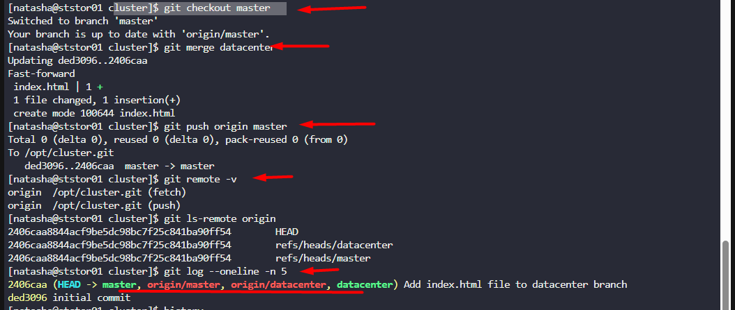

Slide 4
